Slide 1
Learning
The University of Findlay
IRB Process
Presented by Institutional Review Board :

Slide 2
Why?
Historically, human subjects have not been protected
Nuremberg Code
Declaration of Helsinki
The Belmont Report

Slide 3

Nuremberg War Crimes Trials
23 German doctors were charged with crimes against humanity for “performing medical experiments upon concentration camp inmates and other living human subjects, without their consent, in the course of which experiments the defendants committed the murders, brutalities, cruelties, tortures, atrocities, and other inhuman acts.”

Slide 4
The Nuremberg Code (1947)
voluntary consent
benefits outweigh risks
ability of the subject to terminate participation

Slide 5
Declaration of Helsinki
Recommendations Guiding Medical Doctors in Biomedical Research Involving Human Subjects
“Concern for the interests of the subject must always prevail over the interests of science and society.”

Slide 6
Henry K. Beecher
“Ethics and clinical research” New Engl J Med 274 (1966):1354-60.
22 published medical studies presenting risk to subjects without their knowledge or approval
Published in prestigious journals and conducted prestigious institutions

Slide 7
Public Health Service Policy
National Advisory Health Council directed to review and advise
Council recommended prior institutional review for PHS supported research to:
  Protect the rights and welfare of the subjects
  Assure appropriate methods of informed consent
  Determine acceptable balance of risks and benefits
  Adopted as Public Health Service policy in 1966
  Beginnings of the Institutional Review Board (IRB)

Slide 8

Tuskegee Syphilis Study
U.S. Public Health Service research study from 1932 to 1972
examined the “natural” course of untreated syphilis in African American men.

Slide 9
National Research Act
1973 Kennedy Hearings “Quality of Health Care - Human Experimentation”
1974 National Research Act
Established the “National Commission for the Protection of Human Subjects of Biomedical and Behavioral Research”
Required IRBs at institutions receiving HEW support for human subjects research

Slide 10
The Belmont Report
Released by Commission for the Protection of Human Subjects of Biomedical and Behavioral Research
Ethical Principles and Guidelines for the Protection of Human Subjects of Research
April 1979
Basic Ethical Principles:
  Respect for Persons
  Beneficence
  Justice

Slide 11
UF Policy

Slide 12
Research
All research done at The University of Findlay is guided by codes of ethical principles developed by the scientific community.
The manner in which these ethical principles are to be applied (through a peer review process) is established in the Code of Federal Regulations, Title 45, Part 46 (commonly referred to as 45 CFR 46) published in 1981 and last amended in 1991.

Slide 13

The Internal Review Board (IRB)
The University of Findlay has an internal review board charged with reviewing all research conducted at the University for conformity to 45 CFR 46.

Slide 14
The University of Findlay
is responsible for the protection of the rights and welfare of human subjects used in research by, or under the supervision of, faculty and staff members of the University
To meet this responsibility, the IRB will review all proposed research projects involving human subjects conducted by faculty members, University staff, or students, whether funded or not, when facilities, services, or personnel of the University are used.

Slide 15
Research Determination
Does activity involve research?
Does research involve human subjects?
Is the human subject research exempt?
Is your institution engaged?
UF Research Determination Worksheet

Slide 16
Does the Activity Involve Research?
Research – a systematic investigation designed to develop or contribute to generalizable knowledge
includes research development, testing, evaluation, pilot studies

Slide 17
Does the Research Involve
Human Subjects?
Human subject – a living individual about whom an investigator conducting research obtains
data through intervention or interaction with the individual, or identifiable private information

Slide 18
Is the Human Subject Research Exempt?
Categories of Exempt Research*
Normal educational practices in established educational settings
Educational tests, surveys,
Research on elected or appointed public officials or candidates for public office
Research using existing data, if publicly available or recorded without identifiers
Evaluation of public benefit interviews, or observation of public behavior –unless identified & sensitive
Taste and food quality evaluation and consumer acceptance studies
46.101(b)(1-6) 27
* Exception for prisoners
** Exception for children
IRB determines status

Slide 19
Criteria for IRB Approval
Findings under §46.111
Risks minimized
Risk/benefit ratio reasonable
Subject selection equitable
Informed consent – obtained & documented (unless waived)
Data monitored
Privacy and confidentiality
Safeguards for vulnerable subjects

Slide 20
Level of Risk
The degree to which participants are at risk for incurring physical, emotional, psychological or economic risk determines the level of IRB scrutiny. The following categories are generally used to classify participants:
Less-Than-Minimal Risk: No known or anticipated physical, emotional, psychological or economic risk.
Minimal Risk: Presents only the kind of risk encountered in daily life (e.g. moderate exercise, minor stress from testing or surveys on sensitive topics).
Greater-Than-Minimal Risk: Risks beyond that ordinarily encountered (e.g. maximal exercise of non-healthy individuals, stressful psychological tests, questions about illegal activities).

Slide 21
Levels of Review
Largely based on the level of risk presented to the subjects.
Exempt: Single IRB member review.
Expedited: Two Reviewers.
Full Review: Full Committee Review. Application reviewed at monthly meeting of the IRB.

Slide 22
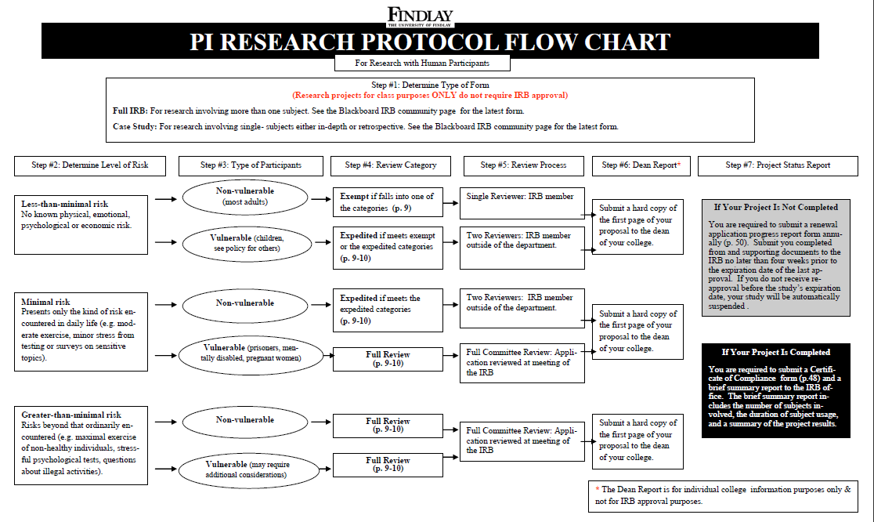

Slide 23
FORMS

Slide 24
IRB Website
All forms, resources, templates, etc are found on the IRB website.

Slide 25
UF IRB Policies
Institutional Review Board Guidelines
UF Research Determination
IRB Proposal
Full Consent form
IRB Implied Consent form
Parent consent form
Assent form
Letter of support template
Confidentiality Statement
HIPAA Identification Authorization Form
HIPAA De-identification form
HIPAA WAIVER OF AUTHORIZATION
All Forms and information is on IRB website.
Forms post approval
IRB Compliance Form
Progress Report
Amendment Modification report
Adverse Event Report

Slide 26
Informed Consent
Key principles of the informed consent process:
  Full disclosure of the nature of the research and the subject's participation
  Adequate comprehension on the part of the potential subjects or legally authorized representative (LAR)
  The subject's voluntary choice to participate or not

Slide 27
Basic Elements of Informed Consent
Research
  Purpose
  duration
Alternatives
Confidentiality
Compensation for injury
  procedures
Risks, discomforts
Benefits
Whom to contact
Right to refuse, withdraw without penalty
§46.116(a)
Note: Additional elements, when appropriate
§46.116(b)

Slide 28
Waiver or Alteration of Informed Consent
IF IRB finds and documents that
  no greater than minimal risk,
  will not adversely affect rights & welfare of subjects,
  research could not practicably be carried out without the waiver or alteration, AND
  when appropriate, subjects will be “debriefed” after participation
  Consistent with §46.116(c) or (d), §46.408, or §46.101(i)

Slide 29
Documentation of Informed Consent
Long form document, embodying elements
Short form, oral presentation of elements Must include script
  Full Consent form
  IRB Implied Consent form
  Parent consent form
  Assent form
46.117(b)

Slide 30
Waiver of Written Documentation
Informed Consent
IRB may waive documentation if it finds either:
  consent form only record linking subject and research; AND
  principal risk from breach of confidentiality.
OR
minimal risk research; AND
research procedures do not require written IC if done outside research context

Slide 31
The Consent Process
Informed consent is not a single event or just a form to be signed -- rather, it is an on-going process that takes place between the investigator and the prospective subject.

Slide 32
Office for Human Research Protections (OHRP)
OHRP Contact Information
Website: www.hhs.gov/ohrp

Slide 33
Health Insurance Portability & Accountability Act (HIPAA)
Need to complete HIPAA forms if collecting data in a HIPAA covered facility.
  HIPAA Identification Authorization Form
  HIPAA De-identification form
  HIPAA WAIVER OF AUTHORIZATION

Slide 34
UF Procedures

Slide 35
Responsibilities of the PI
All research projects submitted to the IRB must have a full time University of Findlay faculty/ staff member designated as the principal investigator.
IRB requires the Principal Investigator (PI) and recommends Student Researchers (SI) have valid human subjects training prior to submitting a proposal to IRB.​
  ​IRB will accept training from sources such as CITI, or NIH. Training from those entities will be considered valid for three years from the date the training was completed.
Monitors ALL aspects of the project throughout the duration of the process through the submission of the Certificate of Compliance form at the conclusion of the project.
Maintains all documents, data etc. a minimum of 3 years.

Slide 36
Human Subjects Training
CITI Program​: UF has subscribed to CITI program to be able to offer Human and Animal subjects training to PI and SI researchers.
https://about.citiprogram.org/en/homepage/
NIH Office of Extramural Research:
http://phrp.nihtraining.com/users/login.php
Office for Human Research Protections (OHRP)
http://www.hhs.gov/ohrp/education/training/index.html
Training modules near bottom of page
On Campus Training Sessions

Slide 37
Submission
  Please submit One hard copy with signatures to Heather Riffle, Academic Affairs
  Please submit One Electronic Copy to irb@findlay.edu
  Please submit a copy of training certificate
  Please submit other enclosures as needed

Slide 38
Instructional Projects Using Human Subjects
Class projects
  small projects that have many characteristics of research,
  purpose - student opportunity for developing familiarity with means of investigation customary to the various disciplines.
  Purpose is not at the collection of data for its own sake, but instead at the development of student knowledge and skills independent of those data.
  To the extent that regular courses involve projects with this intention, which would not later be used as part of a research project,
  Less than minimal risk
  responsibility will be placed by the IRB to the College and faculty so that such projects are carried out in the spirit of the principles governing basic ethical conduct.
In the unlikely event that the class project will involve public dissemination of the results, some professional organizations require proof of IRB approval. It is strongly recommended in these cases that the faculty member submit the project for formal IRB review.

Slide 39
Project Approval Statement
In the event that students attempt to gather data for class projects not approved by the IRB, it is the responsibility of the instructor to require the students to inform potential subjects that the project has been approved by the instructor. The subjects need to be aware how the data will be used, how their anonymity will be protected, and that they are not required to participate. The following statement is recommended:
My name is _______ and I am a student in Professor ________’s class. The following survey is for a class project involving________________ and has been approved by Professor ___________. Participation in this project is strictly voluntary and your anonymity will be protected. The results will be presented for class purposes only. Should you have any questions or concerns about your participation please contact Professor _________ via email at __________.

Slide 40
Decisions
Projects requiring IRB approval are subjected to either an exempt, expedited or full review. The process is outlined in the PI Protocol Guide. Once the review is completed the chair will convey one of the following decisions of the IRB in writing to the investigator:
Approval:
Tabled: Substantive issues regarding the proposal must be addressed.
Disapproved: Questions regarding the rights and welfare of the subjects are of such significance that the Board feels approval of the study be unwarranted.

Slide 41
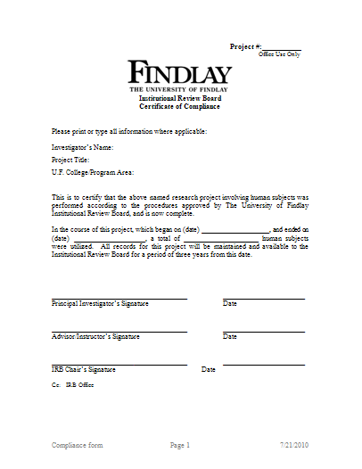
Beyond Data Collection
Once the project is completed the PI is required to submit a Certificate of Compliance form and a brief summary report to the IRB office. Only after the IRB office receives and approves the compliance form is the project officially closed.

Slide 42
Questions??
irb@findlay.edu

