Slide 1
The Flipped Classroom
Lindsey Buddelmeyer, Cyndy Goodwin,
Tara Griffiths, Greg Mott, Andrew Baker
Notes:
Welcome to our presentation on the flipped classroom. I am Cyndy Goodwin, Chair of OT and the rest of the panel is comprised of two of my faculty – Lindsey Buddelmeyer, Tara Griffiths and Greg Mott from the ESL program and his grad student Andrew Baker

Slide 2
Agenda
Introduction – Dr. Goodwin
Faculty experience OT -Dr. Griffiths
Faculty experience OT – Dr. Buddelmeyer
Faculty experience ESL – Dr. Mott
Graduate thesis project – Andrew Baker
Think, pair, share
Questions
Notes:
Here is the plan for this morning. I will give a short overview of our topic. Then Dr. Griffiths will share her experiences with the flipped classroom method as will Dr. Buddelmeyer. Then Dr. Mott will share his experiences from another area – ESL and his student Andrew will describe an ongoing research study he and Dr. Mot are conducting on this method.

Slide 3
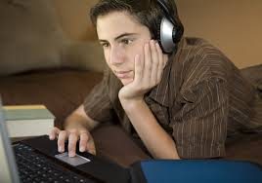
Disclaimer
What flipped classroom is NOT:
Teachers creating videos for students to watch as homework
Notes:
So I will start with this disclaimer.

Slide 4
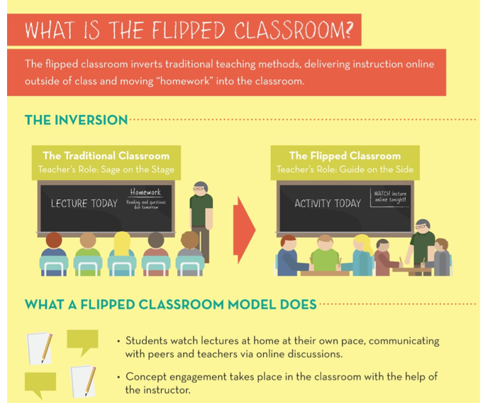
Notes:
This slide represents a quick look at the what the whole concept of flipping refers to which centers on inversion of the traditional sage on the stage teaching to the teacher acting as a guide to a more active learning environment where the students are able to engage because of the preparation they have done outside of class.

Slide 5
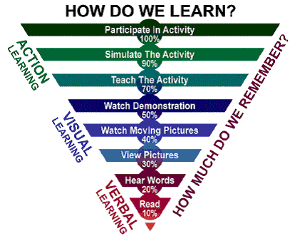
Guiding Principles
Notes:
Anyone who has taught or attended any CE on excellence in teaching is probably familiar with this graph which reminds you about how people learn. Research indicates that the best learning occurs with active involvement and you can see how that is represented here with students increasing their active involvement in the process as you move up the funnel.

Slide 6

Method of Flipping
Lectures provided as recorded presentations, curated videos, third party broadcasts, traditional readings
In class time dedicated to group work, in-depth application activities, open time for individual assignments with faculty acting as consultant to the process
Notes:
So Flipping involves basic, background, foundational materials being provided to students previous to the class meeting time in the form of recorded presentations, powerpoints, videos, etc. The actual meeting class in time is then used for in-depth working with that material to apply it or analyze it, doing work in pairs or small groups to test or try out concepts or skills with time available for consultation with the instructor.

Slide 7

Advantages
Humans learn by doing (Kurzweil)
Puts teacher in the room while the student is applying new knowledge
Classroom becomes a place for active interaction (doing), not passive listening and daydreaming.
Allows students to consume lecture materials at their pace
Mounting evidence that flipping boosts student achievement.
Fits well with occupational therapy philosophy & we’ll also hear application to ESL
Notes:
Some of the advantages of this method are listed here. In OT, we offer our curriculum in both a traditional and weekend format. Our weekend students receive the same content as our traditional students but in a compressed time frame that is intense. When I began teaching weekend students 10 years ago, I was seeking efficient methods to deliver a lot of content but have time for processing and discussion as well. The particular course I was teaching was heavy on basic information – various health conditions that OTs might see in practice – so I decided to post online the powerpoint lectures I would have done in class previous to our class meeting and have the students review those ahead of time. When they came to class, I answered questions and then applied the material in case studies. Occupational Therapy is a doing profession and this approach aligned very well with that philosophy of humans need to learn by doing.

Slide 8

Challenges
Issues raised by students
“I wish you would just teach the class”
“ I learn best through listening to a lecture”
“I shouldn’t have to teach myself the subject”
Technical
Need consistent, accessible video storage
Support for recording
Students need to be able to watch videos anytime, anywhere, on any device
Notes:
Two major categories of challenges that flipping poses are those related to students and then to the technical aspect. Students, as you know, come in all shapes and sizes and especially the younger ones seem to try to get by with doing the least amount of work possible and that does not work when using a flipped approach. And then there are the technical challenges and I’ve listed a few.

Slide 9
Addressing the challenges – student perspectives
Flipped classroom focuses on Assimilation vs. Transmission of knowledge
Flipping makes basic information available prior to class leaving class time for making sense of the harder parts.
Flipping makes students responsible for gaining fluency with basic ideas in preparation for class time rather than as a result of class time.
Flipping facilitates learning how to learn – a skill needed for life
Notes:
So to help students who challenge your wisdom in teaching this way, you will need to lay the groundwork and spend a bit of time at the beginning of the semester talking about the focus on learning or the student’s assimilating new information and you will are not there just to transmit information. They will need this skill for life. Flipping will allow time for you to work more closely with them in the classroom to make sense of the basic info they were provided before the class and apply to higher level performance.

Slide 10
Addressing the challenges - technical
Need VCMS – video content management system
BYOD – bring your own device. Allows instructors to record from anywhere.
Flipping relies on ability of students to view lecture content prior to class whenever and wherever it suits them.
Create “microlectures” that last only 10-15 minutes. Research from Ball State suggests the most effective microlectures may be limited to no more than 7 minutes.
Notes:
As far as the technology, this could be a whole day workshop and our UF CTE can certainly help you, but a couple of important points I want to make are that you need to figure out what works best for you to use to make videos or voice over powerpoints – your video content management system. What technology do you have available and are comfortable with – your smartphone, tablet, portable video camera, UF installed software on your laptop or desktop. You want to have flexibility in when and where you record material
You also need to be cognizant of student expectations that they can view their online course materials anytime, anywhere on any device. They also want to be able to go back and review material without having to scroll through a whole presentation.
In general, you want to post microlectures. The most effective are short – 7-10 minutes. So you may need to break up a lecture into self contained sections.

Slide 11
Early adopter experiences
Tara & Lindsey– examples of classroom activities for blended learning; discuss technology challenges for faculty & students; discuss student responses and outcomes in their OT courses
Greg will share use of this method in ESL and his graduate student Andrew Baker will describe a current research project on its use
Notes:
The use of flipping has been expanding in our OT program, so next you will hear from Tara & Lindsey about their experiences followed by Greg and his student in the ESL program.

Slide 12
The Flipped Classroom
Dr. Tara Griffiths

Slide 13
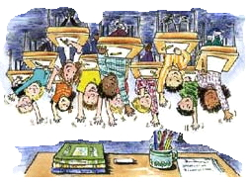
The Flipped Classroom Experience
How did it happen?
Non-traditional
Where is it now?
Traditional

Slide 14
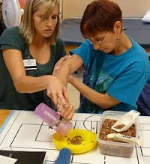
Activities in a Flipped Classroom
Application of material
Case studies
Simulations with peers
Real case scenarios

Slide 15
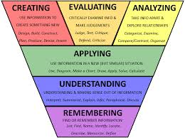
Classroom Activities

Slide 16
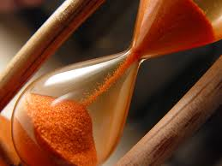
Challenges
Time
Technology
Workload

Slide 17
How students responded
“ I found the recorded sessions extremely useful to review classroom material before and after class.”
“ Allowing more time to apply what we learned in class made me feel better prepared for fieldwork”
“Using the class to work on more application of material helped me tremendously”
“I felt that having access to recorded lectures before class was useful to ask more in-depth questions and learn more”
“The PowerPoints took a long time to load”

Slide 18

Why and How I Flip The Classroom!!
Dr. Lindsey Buddelmeyer

Slide 19
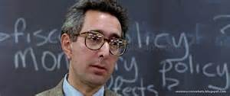
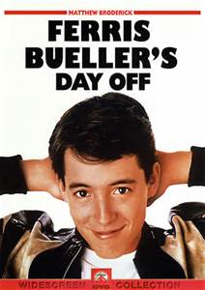
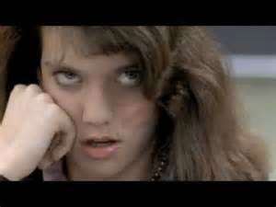
Have you ever felt like this….. Flipping has been useful for both the weekend college and traditional tracks that the OT program currently offers.
https://www.youtube.com/watch?v=uhiCFdWeQfA

Slide 20
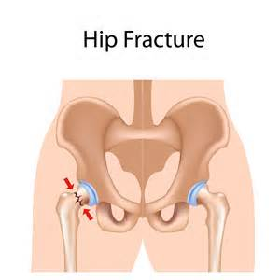

Examples that have worked well for me……
Recording Narrated Power Points
Making the slides available and collecting their notes to ensure they have viewed the PP.
Being transparent with the structure and expectations to make these application-based experiences happen.
Interactive case studies
There is a tutorial to go through first & then students fill out an evaluation on the case study.
Provides information on tests and assessments and gives normal therapeutic ranges and lab results.
Interdisciplinary team
*Students complete individually on their computers and then process and discuss in small groups.

Slide 21


Connecting content to real life experiences through film and interactive experiences:
Grey’s Anatomy
Diabetic Dog/nobelprize.org
Chronic Care management
Understanding of what happens when insulin is to low or to high and how the sugar levels respond to certain foods, exercise, and injections.

Slide 22

Student Responses….
“This series has helped me to see how and how not to communicate with
other professionals in the health care setting.”
“Grey’s Anatomy has enhanced my knowledge because it shows real life situations. Also, it demonstrates how some medical providers treat their patients. I also learned the importance of understanding the needs and wants of the patient versus my own. I learned listening to the client is the only way we can figure out what they want. Finally, learning to read peoples emotions and facial expressions are key in the medical world.”
“Watching the Grey’s Anatomy series in class has helped me look at various conditions and see how it will impact the persons life as an occupational being. Different conditions can impact a person’s life in a number of ways. The episodes this far have reinforced various concepts of the framework. The show expands thinking about certain conditions and how they will impact the person’s occupational performance, performance skills, ADLs, IADLs, etc. The show allows us to apply the OTPF in a different way and I feel that enhances our learning and expands the knowledge we have.”

Slide 23
Implications for ESL
Greg Mott

Slide 24
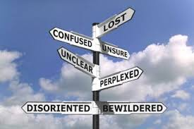
Frequent Challenges in ESL
Language barrier
ESL students may struggle to understand live lectures accurately.
Hearing lectures (vocabulary, rate of speed, accents/dialects)
Reading a professor’s notes
Conceptualizing the abstract, synthesizing ideas.
ESL students may lack the language ability to ask for help.

Slide 25

Frequent Challenges in ESL
Cultural barrier
ESL students may have different expectations…
…for attendance and absences.
…for meeting deadlines.
…for working collaboratively.
…for what is considered plagiarism.
Student/teacher communication
Social norm in home country
Comfort level

Slide 26
The Flipped Classroom Model in ESL
May aid students with language concerns:
Opportunity to hear instruction more than once.
Have time to address unknown vocabulary words.
ESL video clips are designed for ESL listeners; removes live instruction error.
Uses appropriate rate of speech and clear pronunciation.
May aid students in asking questions
Questions should be noted during instruction-video “homework”.

Slide 27
The Flipped Classroom Model in ESL
May address cultural barriers
Absent students would not miss instruction.
Homework assessment is done in class rather than at home.
Class time provides more room for collaborative work and role play.
Cheating/copying/plagiarism less likely to go unnoticed!!

Slide 28
Graduate Thesis Project
Andrew Baker

Slide 29
Graduate Thesis Project
To find out English Language Learners’ perspectives on the flipped classroom.
TESOL/IELP mentor program
Working with Greg Mott and doing a classroom flip over 6 weeks.
Mr. Mott and Mr. Baker are planning lessons and making observations together.

Slide 30
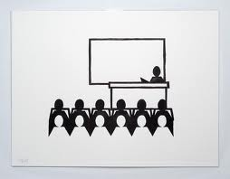
Research and Rationale
Lecture has always been a staple of academia, but there are issues and limits of its effectiveness.
Active learning has been shown to be superior to using lecture exclusively. Especially with learning skills.

Slide 31

Research and Rationale
Millennial generation students have different needs than previous generations because of the influx of technology.
The brain is limited in how much information at it can store at one time.

Slide 32
Research and Rationale
Flipped classrooms have proven to be effective in encouraging more group collaboration, independent learning, and motivation.
Flipped classrooms have also met resistance from…
students who preferred live lecture.
students who were disoriented by uncommon format.
those who see no positive outcome on grades.

Slide 33
Early observations
Test / final exam review!
Consistency between different sections of the same course.
Some students do not have a printer →
provide handouts, or combine into one download.
Student with medical condition, no screen →
provide corresponding textbook pages on handouts
Confusing assignment at first →
less demand early, more demand later.

Slide 34
Small Group Discussions
Think, pair, share – how do you think you can incorporate into your classroom?
Notes:
So now we’d like you to think about how any of our experiences you might apply in your classroom. IF not for a whole class, how about beginning with one module of content you have to deliver. Think about that and turn to your neighbor or small group in your area and share your thoughts and concerns and then we’ll take questions.

Slide 35
Questions for the Panel?

Slide 36
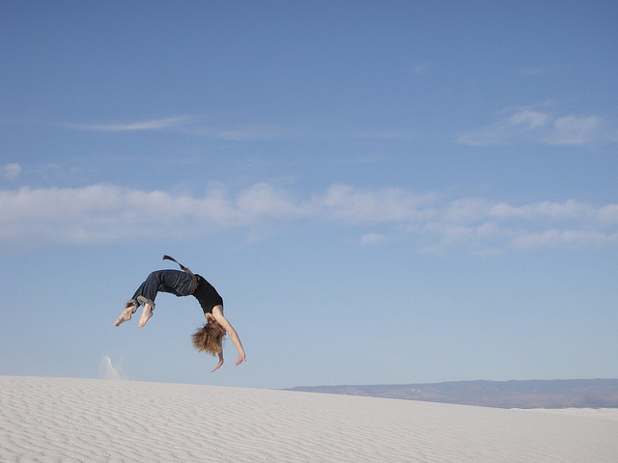
Thank you
Go forth and flip!!

